Slide 1
Chapter 6
Process Synchronization
PART II

Slide 2
Outline
Classical Problems of Synchronization
Critical Regions
Monitors
Synchronization in Solaris 2 & Windows 2000
Serializability and Concurrency Control

Slide 3
Classical Problems of Synchronization
Bounded-Buffer Problem
Readers and Writers Problem
Dining-Philosophers Problem
The three problems are important, because they are
  examples for a large class of concurrency-control problems.
  used for testing nearly every newly proposed synchronization scheme.
Semaphores are used for synchronization in our solutions.
(2 separate resources)

Slide 4
Bounded-Buffer Problem
buffer of size n
Shared data
semaphore full, empty, mutex;
Initially:
full = 0, /* # of full slots
empty = n, /* # of empty slots
mutex = 1
producer
consumer

Slide 5
Bounded-Buffer Problem
Producer
Consumer
do {
...
produce an item in nextp
...
wait(empty);
wait(mutex);
  ...
add nextp to buffer
...
signal(mutex);
signal(full);
} while (1);
do {
wait(full);
wait(mutex);
...
remove an item from buffer to nextc
...
signal(mutex);
signal(empty);
...
consume the item in nextc
...
} while (1);
0, iff no item
0, iff no buffer
free one
buffer
add one item

Slide 6
Readers-Writers Problem (1)
each writer is required to have exclusive access to the shared object.
At the same time, either several reads, or only a write
Shared data
semaphore mutex, wrt;
readcount: (0, initially; # of current readers)
mutex: (1, initially; mutual exclusion for readcount)
wrt: (1, initially)
    mutual exclusion for writers
    It also is used by the first-in and last-out readers

Slide 7
Readers-Writers Problem (2)
If a writer is in the CS and n readers are waiting, then
  one (1st) is queued on wrt
  the other n-1 are queued on mutex
When a writer executes signal(wrt), either the waiting readers or a single writer are resumed. The selection is made by the scheduler.

Slide 8
Readers-Writers Problem (3)
Two variations (priorities of readers and writers)
No reader will be kept waiting unless a writer has already obtained permission to use the shared object.
(Thus, no reader should wait for other readers to finish simply because a writer is waiting.) Writers may starve
Once a writer is ready, that writer performs its write as soon as possible.
(Thus, if a writer is waiting to access the object, no new readers may start reading.) Readers may starve

Slide 9
Readers-Writers Problem (4)
for the first solution
reader
first-in
writer
wait(mutex);
readcount++;
if (readcount == 1) wait(wrt);
signal(mutex);
...
reading is performed
...
wait(mutex);
readcount--;
if (readcount == 0) signal(wrt);
signal(mutex);
wait(wrt);
...
writing is performed
...
signal(wrt);
update
readcount

Slide 10

Dining-Philosophers Problem (1)
five philosophers, either thinking or eating
to eat, two chopsticks are required
taking one chopstick at a time
Shared data
semaphore chopstick[5];
  Initially all values are 1
3
3
2
4
2
4
1
5
1
5

Slide 11
Dining-Philosophers Problem(2)
philosopher i
get chopsticks
left
right
do {
wait(chopstick[i]);
wait(chopstick[(i+1) % 5]);
...
eat
...
signal(chopstick[i]);
signal (chopstick[(i+1) % 5]);
...
think
...
} while(1);
free chopsticks
left
right
deadlock !

Slide 12
Dining-Philosophers Problem (3)
Possible solutions to the deadlock problem
  Allow at most four philosophers to be sitting simultaneously at the table.
  Allow a philosopher to pick up her chopsticks only if both chopsticks are available (note that she must pick them up in a critical section).
  Use an asymmetric solution; that is,
    odd philosopher: left first, and then right
    an even philosopher: right first, and then left
Besides deadlock, any satisfactory solution to the DPP problem must avoid the problem of starvation.

Slide 13
Today Topics :-
Drawbacks of Semaphores.
Monitors Introduction.
Monitors Usage.
Dining-Philosophers Solution Using Monitors.
Implementing a Monitor Using Semaphores.
Resuming Processes within a Monitor.

Slide 14
Drawbacks of Semaphores
Semaphores provide a convenient and effective mechanism for process synchronization.
However, incorrect use may result in timing errors.
signal(mutex);
...
critical section
...
wait(mutex);
wait(mutex);
...
critical section
...
incorrect order
(not mutual exclusive)
forgotten
...
critical section
...
signal(mutex);
wait(mutex);
...
critical section
...
wait(mutex);
typing error
(deadlock)

Slide 15
Monitor: A High-level Language Constructs
Definition: A type, or abstract data type, encapsulates private data with public methods to operate on that data.
A monitor type presents a set of programmer-defined operations that are provided mutual exclusion with in the monitor.

Slide 16
Monitors Usage:
The representation of a monitor type consists of
  declarations of variables whose values define the state of an instance of the type
  procedures or functions that implement operations on the type.
A procedure within a monitor can access only variables defined in the monitor and the formal parameters.
The local variables of a monitor can be used only by the local procedures.
The monitor construct ensures that only one process at a time can be active within the monitor.

Slide 17
Monitors
High-level synchronization construct that allows the safe sharing of an abstract data type among concurrent processes.
monitor monitor-name
{
shared variable declarations
procedure body P1 (…) {
. . .
}
procedure body P2 (…) {
. . .
}
procedure body Pn (…) {
. . .
}
{
initialization code
}
}

Slide 18
Monitors – condition variables
To allow a process to wait within the monitor, a condition variable must be declared, as
condition x, y;
Condition variable can only be used with the operations wait and signal.
  The operation
  x.wait();
  means that the process invoking this operation is suspended until another process invokes
  x.signal();
  The x.signal operation resumes exactly one suspended process. If no process is suspended, then the signal operation has no effect.

Slide 19

Schematic View of a Monitor

Slide 20

Monitor With Condition Variables (1)

Slide 21
Monitor With Condition Variables (2)
Suppose Q executes x.wait and then P executes x.signal.
Both P and Q are in the monitor, one must wait.
Two possibilities for the implementation:
  (a) Signal and Wait :- P either waits Q leaves, or waits another condition
  (b) Signal and Continue :- Q either waits P leaves, or waits another condition
Possibility (b) seems more reasonable

Slide 22
Dining Philosophers Example
A deadlock-free solution to the dining-philosophers problem.
This solution imposes the restriction that a philosopher may pick up her chopsticks only if both of them are available.
In this we have 3 states in which we may find a philosopher .
enum {thinking, hungry, eating} state[5];

Slide 23
Solution to Dining Philosophers
monitor DP
{
enum { THINKING; HUNGRY, EATING) state [5] ;
condition self [5];
void pickup (int i) {
state[i] = HUNGRY;
test(i);
if (state[i] != EATING) self [i].wait;
}
void putdown (int i) {
state[i] = THINKING;
// test left and right neighbors
test((i + 4) % 5);
test((i + 1) % 5);
}

Slide 24
Solution to Dining Philosophers (cont)
void test (int i) {
if ( (state[(i + 4) % 5] != EATING) &&
(state[i] == HUNGRY) &&
(state[(i + 1) % 5] != EATING) ) {
state[i] = EATING ;
self[i].signal () ;
}
}
initialization_code() {
for (int i = 0; i < 5; i++)
state[i] = THINKING;
}
}

Slide 25
Dining Philosophers Solution Using Monitors
monitor dp
{
enum {thinking, hungry, eating} state[5];
condition self[5];
void pickup(int i) // following slides
void putdown(int i) // following slides
void test(int i) // following slides
void init() {
for (int i = 0; i < 5; i++)
state[i] = thinking;
}
}

Slide 26
void pickup(int i) {
state[i] = hungry;
test[i];
if (state[i] != eating)
self[i].wait();
}
void putdown(int i) {
state[i] = thinking; /*allow neighbors to eat
// test left and right neighbors
test((i+4) % 5);
test((i+1) % 5);
}
try to eat
left
right

Slide 27
try to let P_{i} eat
(if it is hungry)
void test(int i) {
if ( (state[(i + 4) % 5] != eating) &&
(state[i] == hungry) &&
(state[(i + 1) % 5] != eating)) {
state[i] = eating;
self[i].signal();
}
}
void init() { /* initialization */
for (int i = 0, i < 5; i++)
state[i] = thinking; }}
if P_{i} is suspended,
resume it
if P_{i} is not suspended,
no effect

Slide 28
An illustration
P₃
thinking
❸
P₄
4
3
P₂
hungry
self[2].wait;
0
2
1
❶
P₀
P₁
❷
eating;
pushdown(1)
test (0) ;
test (2) ;
if P₃ is not eating ⇒ self[2].signal
thinking

Slide 29
Monitor Implementation Using Semaphores
Variables
semaphore mutex; // (initially = 1)
semaphore next; // (initially = 0)
int next-count = 0;
Each external procedure F will be replaced by
Mutual exclusion within a monitor is ensured.
wakeup a
suspended process
compiler
wait(mutex);
body of F;
if next-count>0 then signal(next)
else signal(mutex);
body of F
allow others
to enter
the monitor

Slide 30
Monitor Implementation
For each condition variable x, we have:
semaphore x-sem; // (initially = 0)
int x-count = 0;
The operation x.wait can be implemented as:
x-count++;
if (next-count > 0)
signal(next);
else
signal(mutex);
wait(x-sem);
x-count--;
A signaling process must WAIT until the resumed process either leaves or waits.
NEXT: the signaling processes may suspend themselves.

Slide 31
Monitor Implementation
The operation x.signal can be implemented as:
if (x-count > 0) {
next-count++;
signal(x-sem);
wait(next);
next-count--;
}
no effect, if no process is waiting
wakeup a waiting process

Slide 32
Monitor Implementation, Fig. 6-22
Conditional-wait construct: x.wait(c);
  c – integer expression evaluated when the wait operation is executed.
  value of c (a priority number) stored with the name of the process that is suspended.
  when x.signal is executed, process with smallest associated priority number is resumed next.
Check two conditions to establish correctness of system:
  User processes must always make their calls on the monitor in a correct sequence.
  Must ensure that an uncooperative process does not ignore the mutual-exclusion gateway provided by the monitor, and try to access the shared resource directly, without using the access protocols.
Incorporated the idea of the monitor, such as C#, Java, …

Slide 33
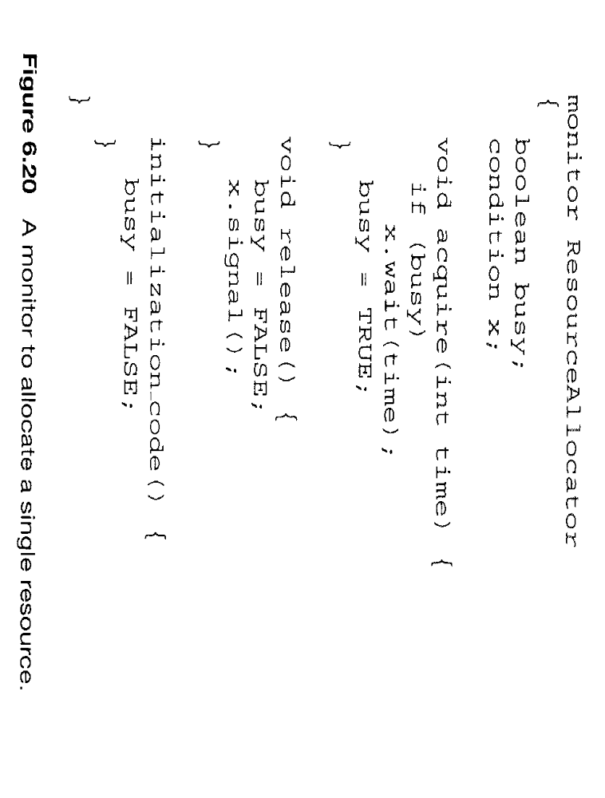

Slide 34
Synchronization Examples
Solaris
Windows XP/2000
Linux
Pthreads

Slide 35
Solaris 2 Synchronization
Implements a variety of locks to support multitasking, multithreading (including real-time threads), and multiprocessing.
Uses adaptive mutexes for efficiency when protecting data from short code segments.
Uses condition variables and readers-writers locks when longer sections of code need access to data.
Uses turnstiles to order the list of threads waiting to acquire either an adaptive mutex or reader-writer lock.
Spinlock if running
block otherwise

Slide 36
Windows 2000 Synchronization
Uses interrupt masks to protect access to global resources on uniprocessor systems.
Uses spinlocks on multiprocessor systems.
(The kernel ensures that a thread will never be preempted while holding a spinlock.)
Provides dispatcher objects which may act as with mutexes and semaphores.
Dispatcher objects may also provide events. An event acts much like a condition variable.

Slide 37
Windows XP Synchronization
Uses interrupt masks to protect access to global resources on uniprocessor systems
Uses spinlocks on multiprocessor systems
Also provides dispatcher objects which may act as either mutexes and semaphores
Dispatcher objects may also provide events
  An event acts much like a condition variable

Slide 38
Linux Synchronization
Linux:
  disables interrupts to implement short critical sections
Linux provides:
  semaphores
  spin locks

Slide 39
Pthreads Synchronization
Pthreads API is OS-independent
It provides:
  mutex locks
  condition variables
Non-portable extensions include:
  read-write locks
  spin locks

Slide 40
Serializability and Concurrency-control Algorithms
Serializability
Locking protocol
Timestamp-based protocols

Slide 41
Serializability (1)
serial schedule: A schedule where each transaction is executed atomically.
Schedule A
T₀ T₁
read(A)
write(A)
read(B)
write(B)
read(A)
write(A)
read(B)
write(B)
nonserial schedule: allow two transactions to overlap their execution.
Schedule B
T₀ T₁
read(A)
write(A)
read(A)
write(A)
read(B)
write(B)
read(B)
write(B)

Slide 42
Serializability (2)
O_{i} and O_{j} conflict if they access the same data item and at least one of them is a write.
Conflict serializable: A schedule S can be transformed into a serial schedule S′ by a series of swaps of nonconflicting operations.
Schedule B ⇒ Schedule A
r(A)₁w(A)₁ r(B)₀w(B)₀⇒ r(B)₀w(B)₀r(A)₁w(A)₁
Swap the read(B) of T₀ with the write(A) of T₁
Swap the read(B) of T₀ with the read(A) of T₁
Swap the write(B) of T₀ with the write(A) of T₁
Swap the write(B) of T₀ with the read(A) of T₁
Schedule B will produce the same final state as well some serial schedule.

Slide 43
Locking Protocol (1)
One way to ensure serializability is to associate with each data item a lock, and require that each transaction follow a locking protocol that governs how locks are acquired and released.
Two lock modes
  Shared: allows read but not write
  Exclusive: allows both read and write
Two-phase locking protocol: requires that each transaction issue lock and unlock in two phases: growing and shrinking.
The order between every pair of conflicting transactions is determined at execution time.

Slide 44
Locking Protocol (2)
growing phase: may obtain lock, but can not release any lock.
shrinking phase: may release lock, but can not obtain any lock.
Initially, a transaction is in the growing phase. The transaction acquires locks as needed. Once the transaction releases a lock, it enters the shrinking phase, and no more lock requests can be issued.
The two-phase locking protocol ensures conflict serializability. It does not, however, ensure freedom from deadlock.

Slide 45
Timestamp-based Protocols (1)
Select the order among transactions in advance
Timestamps could be
  System clock
  Logical counter
Implementation
  W-timestamp(Q): denotes the largest timestamp of any transaction that executed write(Q) successfully.
  R-timestamp(Q): denotes the largest timestamp of any transaction that executed read(Q) successfully.
These timestamps are updated whenever a new read(Q) or write(Q) instruction is executed.

Slide 46
Timestamp-based Protocols (2)
Timestamp-based protocols
  Suppose T_{i} issues read(Q):
    If TS(T_{i}) < W-timestamp(Q), [read a value of Q that was already overwritten] read(Q) is rejected, and T_{i} is rolled back.
    If TS(T_{i}) > W-timestamp(Q), read(Q) is executed, and R -timestamp(Q) is set to the maximum of R-timestamp(Q) and TS(T_{i}).
  Suppose T_{i} issues write(Q):
    If TS(T_{i}) < R-timestamp(Q), [the value of Q that is producing was needed previously and T_{i} assumed that this value would never be produced] write(Q) is rejected, and T_{i} is rolled back.
    If TS(T_{i}) < W-timestamp(Q), [is attempting to write an obsolete value] write(Q) is rejected, and T_{i} is rolled back.
    Otherwise, write(Q) is executed.

Slide 47
Timestamp-based Protocols (3)
A transaction that is rolled back by the concurrency-control scheme as a results of the issuing of either a read or write is assigned a new timestamp and is restarted.
TS(T₂) < TS(T₃)
T₂ T₃
read(B) 10:00
read(B) 10:01
write(B) 10:02
read(A)
read(A)
write(A)
The timestamp-ordering protocol ensures conflict serializability. The protocol ensures freedom from deadlock because no transaction ever waits.

Slide 48
Testing Serializability of a Schedule
Input: A Schedule S for a set of transactions T₁, …, T_{k}.
Output: A determination whether S is serializable, and if so, a serial schedule equivalent to S.
Method: Let S be s schedule of actions a₁, …, a_{n}. Create a digraph (precedence graph) G, whose nodes correspond to the transactions.
T_{j} → T_{s} if a_{i} =T_{j} : UNLOCK a_{m} and a_{p} is the next action following a_{i} of the form T_{s}: LOCK a_{m}.
If G has a cycle, then S is not serializable.
If G has no cycle, then find a linear order by topological sorting.
Theorem. The above algorithm correctly determines if a schedule is serializable.

Slide 49
Two-phase Locking guarantees Serializability
Theorem: If S is any schedule of two-phase locking, then S is serializable.
Proof: Suppose not, by the above theorem, the precedence graph G for S has a cycle, T₁, T₂, …, T_{p}, T₁.
Then some lock by T₂ following an unlock by T₁; some lock by T₃ following an unlock by T₂, and so on.
Finally, some lock by T₁ following an unlock by T_{p}. Therefore, a lock of T₁ follows an unlock of T₁, contradicting the assumption that T₁ is a two-phase. #

